Slide 1
Introduction to Camera Calibration and Distortion Model
Wei Li
School of Automation Engineering, UESTC

Slide 2
Contents
Introduction
A Flexible New Technique for Camera Calibration
Motivation
Basic Equations
Maximum Likelihood Estimation
Experimental Results
Practice

Slide 3
Introduction

Slide 4
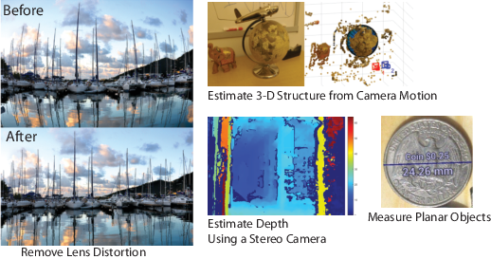
Why Do We Need Camera Calibration?
We can correct for lens distortion, measure the size of an object in world units, or determine the location of the camera in the scene by camera calibration. They are also used in robotics, for navigation systems, and 3-D scene reconstruction.

Slide 5
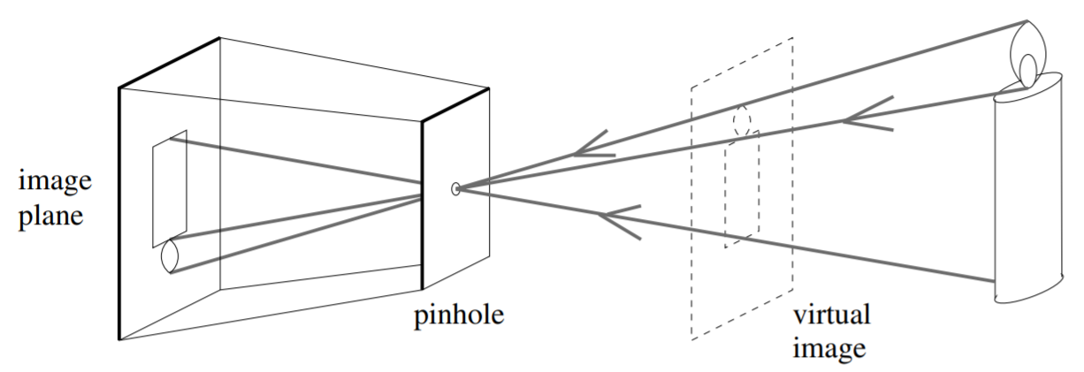
Pinhole Model

Slide 6
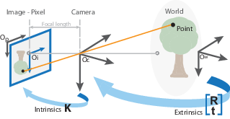
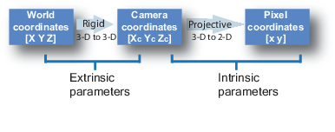
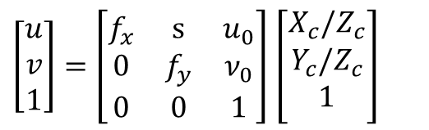
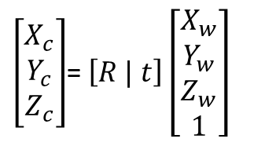
Camera Imaging Model
$\left[\begin{matrix}u \\ v \\ 1\end{matrix}\right]=\left[\begin{matrix}f_{x} & s & u_{0} \\ 0 & f_{y} & ν_{0} \\ 0 & 0 & 1\end{matrix}\right]$ $\left[\begin{matrix}X_{c}/Z_{c} \\ \begin{aligned}Y_{c}/Z_{c} \\ 1\end{aligned} \\ \end{matrix}\right]$
$\left[\begin{matrix}X_{c} \\ Y_{c} \\ Z_{c}\end{matrix}\right]$= $\left[R | t\right]\left[\begin{matrix}X_{w} \\ Y_{w} \\ \begin{aligned}Z_{w} \\ 1\end{aligned}\end{matrix}\right]$
3-D to 2-D
3-D to 3-D

Slide 7
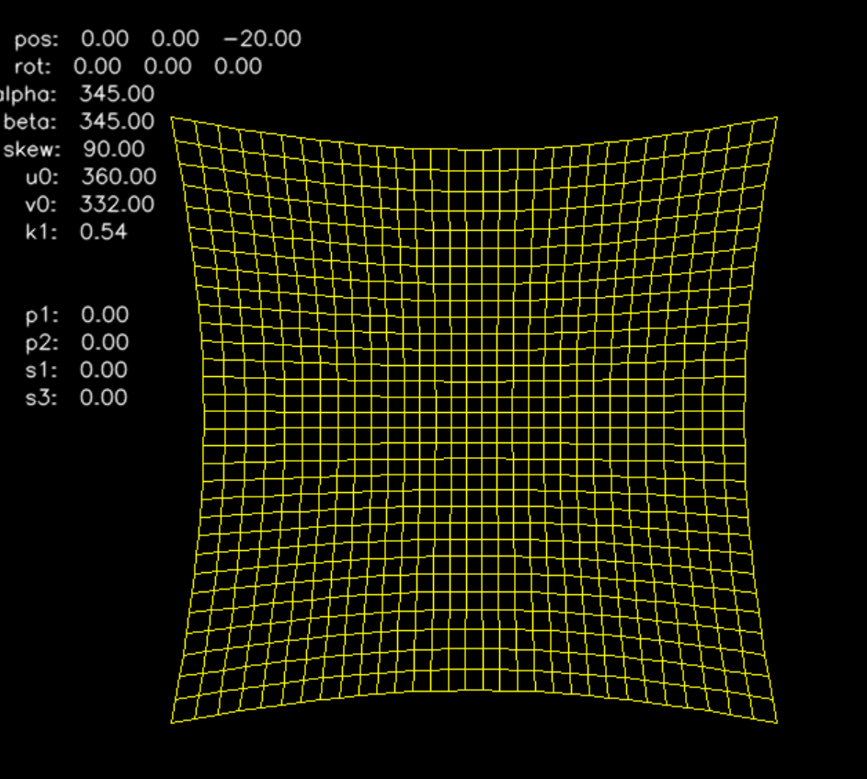
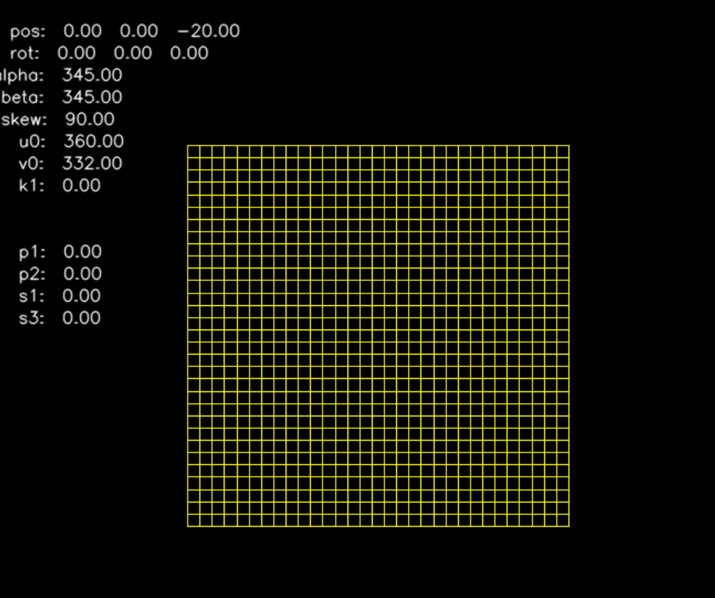
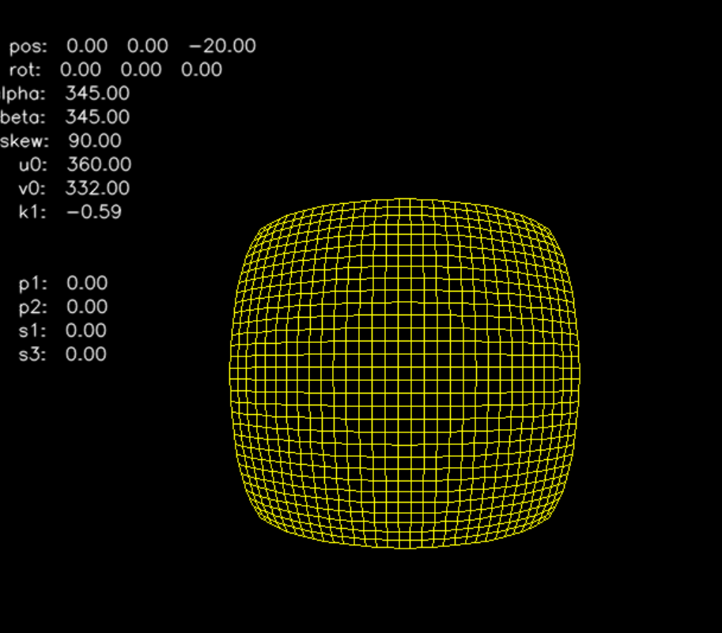
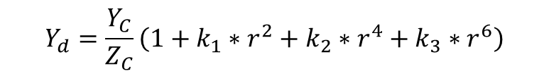
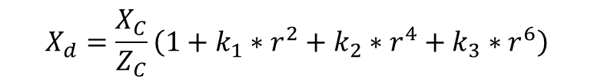
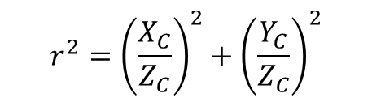
Camera Distortion
radial distortion
$$X_{d}=\frac{X_{C}}{Z_{C}}\left(1+k_{1}∗r^{2}+k_{2}∗r^{4}+k_{3}∗r^{6}\right)$$
$$Y_{d}=\frac{Y_{C}}{Z_{C}}\left(1+k_{1}∗r^{2}+k_{2}∗r^{4}+k_{3}∗r^{6}\right)$$
$$r^{2}={\left(\frac{X_{C}}{Z_{C}}\right)}^{2}+{\left(\frac{Y_{C}}{Z_{C}}\right)}^{2}$$

Slide 8
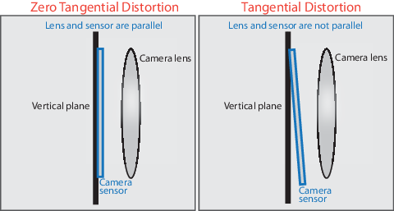
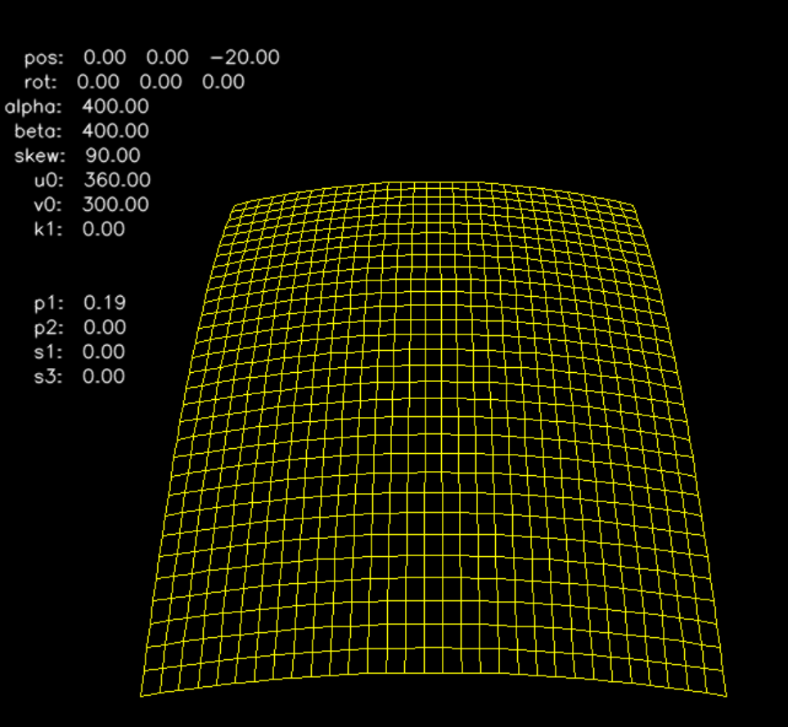
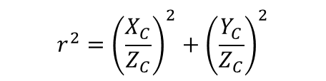
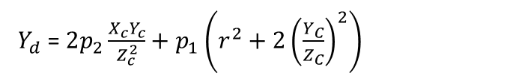
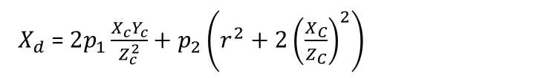
Camera Distortion
tangential distortion
$X_{d}$= $2p_{1}\frac{X_{c}Y_{c}}{Z_{c}^{2}}+p_{2}\left(r^{2}+2{\left(\frac{X_{C}}{Z_{C}}\right)}^{2}\right)$
$Y_{d}$= $2p_{2}\frac{X_{c}Y_{c}}{Z_{c}^{2}}+p_{1}\left(r^{2}+2{\left(\frac{Y_{C}}{Z_{C}}\right)}^{2}\right)$
$$r^{2}={\left(\frac{X_{C}}{Z_{C}}\right)}^{2}+{\left(\frac{Y_{C}}{Z_{C}}\right)}^{2}$$

Slide 9


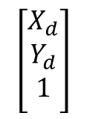
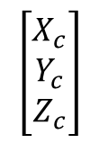
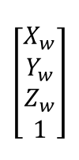

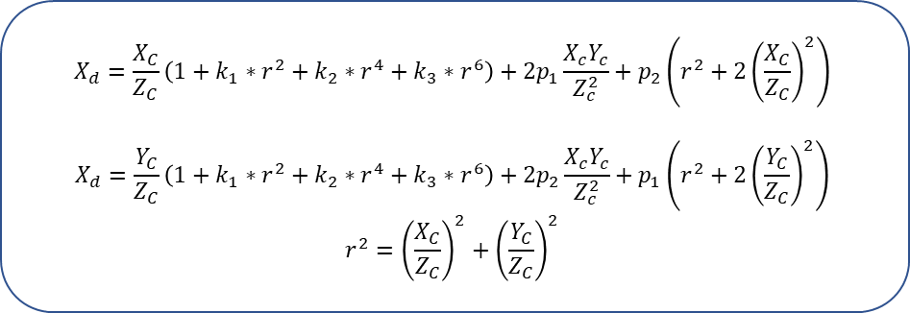
Real Camera Model
Normal distortion image coordinate
Camera coordinate
World coordinate
image coordinate
$K=\left[\begin{matrix}f_{x} & s & u_{0} \\ 0 & f_{y} & ν_{0} \\ 0 & 0 & 1\end{matrix}\right]$
$$\left[R | t\right]$$
$$\left[\begin{matrix}X_{w} \\ Y_{w} \\ \begin{aligned}Z_{w} \\ 1\end{aligned}\end{matrix}\right]$$
$$\left[\begin{matrix}u \\ v \\ 1\end{matrix}\right]$$
$$\left[\begin{matrix}X_{d} \\ \begin{aligned}Y_{d} \\ 1\end{aligned} \\ \end{matrix}\right]$$
$$\left[\begin{matrix}X_{c} \\ Y_{c} \\ Z_{c}\end{matrix}\right]$$
Distortion
$$X_{d}=\frac{X_{C}}{Z_{C}}\left(1+k_{1}∗r^{2}+k_{2}∗r^{4}+k_{3}∗r^{6}\right)+2p_{1}\frac{X_{c}Y_{c}}{Z_{c}^{2}}+p_{2}\left(r^{2}+2{\left(\frac{X_{C}}{Z_{C}}\right)}^{2}\right)$$
$$X_{d}=\frac{Y_{C}}{Z_{C}}\left(1+k_{1}∗r^{2}+k_{2}∗r^{4}+k_{3}∗r^{6}\right)+2p_{2}\frac{X_{c}Y_{c}}{Z_{c}^{2}}+p_{1}\left(r^{2}+2{\left(\frac{Y_{C}}{Z_{C}}\right)}^{2}\right)$$
$$r^{2}={\left(\frac{X_{C}}{Z_{C}}\right)}^{2}+{\left(\frac{Y_{C}}{Z_{C}}\right)}^{2}$$

Slide 10
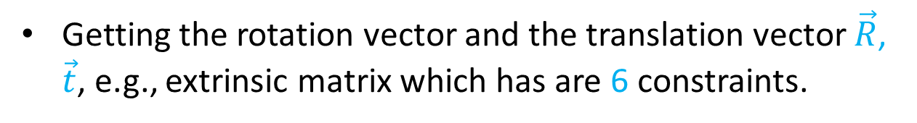
Purpose of camera calibration
Getting the rotation vector and the translation vector $\vec{R}$, $\vec{t}$, e.g., extrinsic matrix which has are 6 constraints.
Getting the intrinsic matrix $\vec{K}$ which has are 5 constraints.
Getting the distortion coefficients k1, k2, k3, p1, p2.

Slide 11
A Flexible New Technique for Camera Calibration
Zhengyou Zhang

Slide 12
Motivation
ﬂexibility
Current research is focused on a desktop vision system (DVS) . since the potential for using DVSs is large. Cameras are becoming cheap and ubiquitous. A DVS aims at the general public, who are not experts in computer vision.
robustness
The camera calibration algorithm is very stable through several comparative experiments
low cost
A typical computer user will perform vision tasks only from time to time, so will not be willing to invest money for expensive equipment.

Slide 13
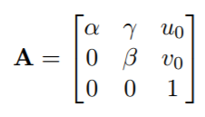
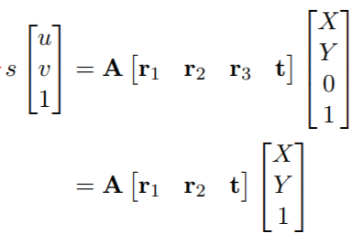
Basic Equations
Let's say the k matrix is the A matrix
Suppose that the checkerboard grid's world coordinates are at Z=0, and the first corner point is the origin of the coordinates

Slide 14

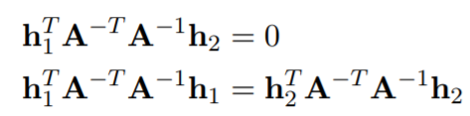
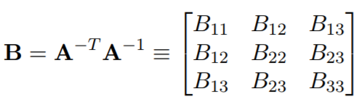
Basic Equations
Let H be the homography
Since r1 is orthogonal to r2 and the modulus of r1 is 1, two sets of constraint equations are obtained
Next

Slide 15
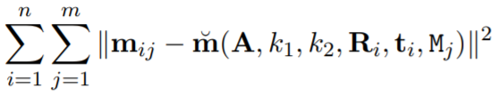
Maximum Likelihood Estimation
Maximum likelihood estimation, include distortion coefficients
Solution method is LM algorithm
When the current solution is far from the correct one the algorithm behaves like a correct one, the algorithm behaves like a steepest descent method: slow, but guaranteed to converge.
When the current solution is close to the correct solution, it becomes a Newton’s method.

Slide 16
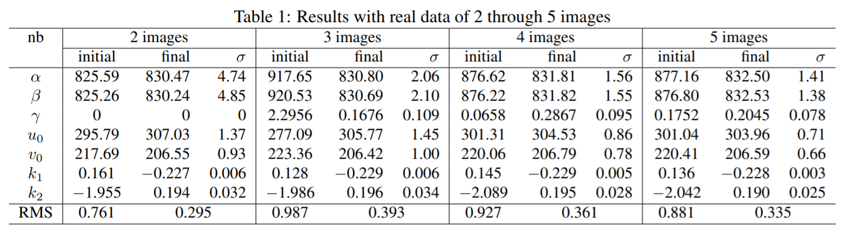
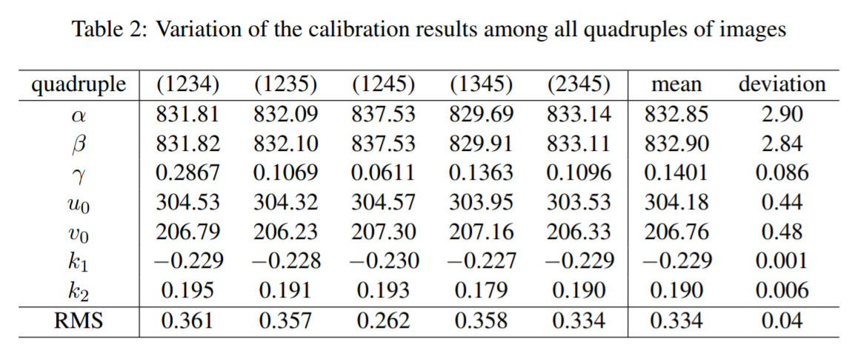
Experimental Results

Slide 17
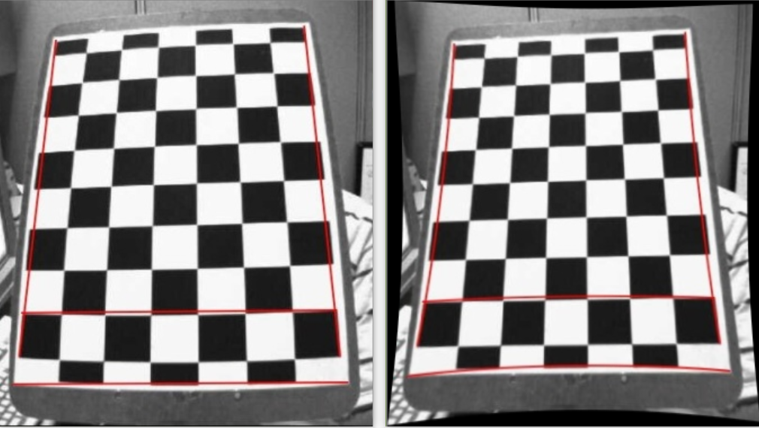
Practice

Slide 18
Thanks !

